Slide 1
MACHINE LEARNING -MINI PROJECT
A COMPARISON OF ARIMA AND LSTM IN TIME FORCASTING
TIME SERIES
Sima Siami-Namini
Department of Applied Economics
Texas Tech University
Email: sima.siami-namini@ttu.edu
Neda Tavakoli
Department of Computer Science
Georgia Institute of Technology
Email: neda.tavakoli@gatech.edu
Akbar Siami Namin
Department of Computer Science
Texas Tech University
Email: akbar.namin@ttu.edu
TEAM MEMBERS : Keshav kumar singh (1806113)
Ankit kumar choudhary (1806115)
Siddharth (1806118)

Slide 2
DATA COLLECTION
For this project we have used seven datasets which are following :
S&P 500 historical data (1733 * 6)
"LeBron James" Google Trends (170 * 2)
"Coldbrew" Google Trends (170 * 2)
"Kentucky Derby" Google Trends (170 * 2)
"Gilmore Girls" Google Trends (170 * 2)
"Olympics" Google Trends (170 * 2)
"Zika Virus" Google Trends (170 * 2)
TECHNIQUES USED
time series analysis and forecasting
pandas and numpy for datetime, data preparation
statsmodel and keras for ARIMA and LSTM modeling

Slide 3
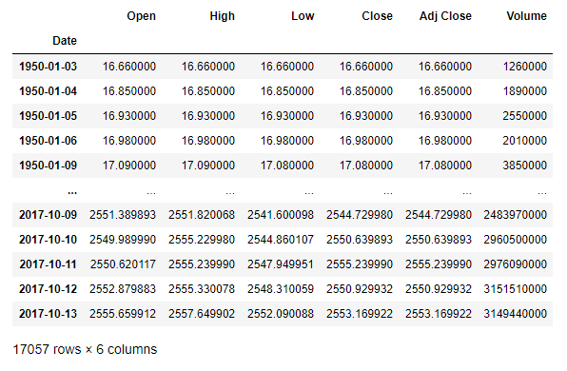
S&P 500 DATASET

Slide 4
MODELS USED
ARIMA
An autoregressive integrated moving average model is a form of regression analysis that gauges the strength of one dependent variable relative to other changing variables. The model's goal is to predict future securities or financial market moves by examining the differences between values in the series instead of through actual values.
LSTM
Long Short Term Memory networks – usually just called “LSTMs” – are a special kind of RNN, capable of learning long-term dependencies. LSTMs are explicitly designed to avoid the long-term dependency problem. Remembering information for long periods of time is practically their default behavior.

Slide 5
Autoregressive Integrated Moving Average (ARIMA)
The function below creates an ARIMA model rolling forecast for a given input time series. The various steps in the function include:
log transforming data
creating train/test splits
creating an ARIMA model for the train set
forecasting the first value in the test set, followed by adding that value to the training set and remodeling, forecasting the next value in the test series, adding that second value to the train set, and so on.
inverse transforming the data
creating plots and generating error metrics.

Slide 6
Long short term memory (LSTM)
The LSTM calculations use three different functions for creating a dataset that can be modeled. Each function is described in more detail below.
Creating the dataset : This function is used to create the datasets required for training and testing LSTM neural nets. It accepts a time series, the number of previous periods the user would like to model, the train / test split fractions, and whether to perform differencing or log transforms on the data to make it stationary. It will also scale all data between 0 and 1 for input into the LSTM.
Inverse transformations : This inverse transform function simply reverses any transformations performed when generating the dataset. Inversing the transformations allows for the model predictions to be based on the same scale as the original dataset for more intuitive interpretation of results. Both the model creation and inverse transformation functions are automatically called within the LSTM function below.
LSTM modelling : Calling the LSTM model only requires a time series dataset, the number of desired look-back periods, the train/test split, whether to log transform or difference the data, and parameters for training such as number of nodes and epochs. Within the function, it creates the train and test datasets—both features and targets—and then trains an LSTM model, followed by forecasting the out-of-sample data. The predictions from the model, as well as the actual target values are then inverse transformed using the function above, and plots are generated along with error metrics.

Slide 7
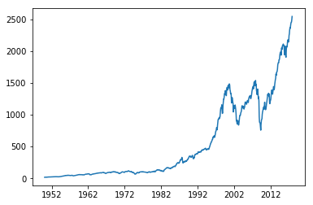
S&P 500 HISTORICAL DATA
The ARIMA model performed slightly better than the LSTM model, but the improvements were mostly negligible. Gaussing filtering the data improved accuracy for both models.
S&P 500 historical closing price data from 1950 through October 2017 (obtained through Yahoo Finance). The data is averaged monthly and plotted in the graph. This trend shows increasing values over time, along with some steep increases and decreases.
Outcomes:
ARIMA RMSE (no filter): 45.50
LSTM RMSE (no filter): 46.67
ARIMA RMSE (filtered): 24.57
LSTM RMSE (filtered): 24.75

Slide 8
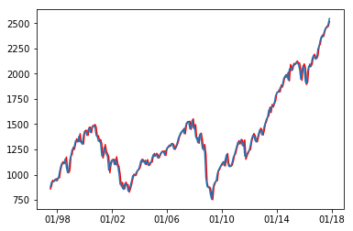
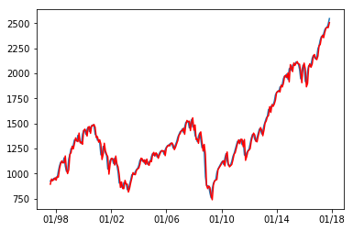
S&P 500 ARIMA model
The ARIMA predictions below have an average RMSE value of 45.5 (with the range of actual values being from ~800 to 2500). One differencing period and log transformation was used.
S&P 500 LSTM model
The LSTM model below also uses log transformation and differencing, with 5 training epochs to update model weights. It has a very similar average RMSE error of 46.7.

Slide 9
RESULT
Data Set | ARIMA (test RMSE) | LSTM (test RMSE) | Gaussian ARIMA (RMSE) | Gaussian LSTM (RMSE)
S&P 500 | 45.495 | 46.671 | 24.570 | 24.751
LeBron James | 20.009 | 27.175 | 9.816 | 13.743
Cold Brew | 9.157 | 8.597 | 3.025 | 4.543
Kentucky Perby | 30.935 | 30.224 | 15.232 | 15.232
Gilmore Girls | 12.026 | 13.885 | 6.517 | 7.592
Olympics | 17.420 | 18.506 | 9.146 | 11.078
Zika Virus | 16.771 | 16.040 | 8.543 | 8.586

Slide 10
CONCLUSION
Overall, the results demonstrate that both ARIMA and LSTM are quality algorithms for forecasting time series data. In general, the ARIMA model provided slightly lower errors, but also can suffer from convergence errors for series with sharp gradients. The LSTM series can train and make predictions on any series—though the accuracy must be evaluated.
Further, Gaussian filtering of the dataset improved predictions in every case, even when comparing the filtered predictions to the original, un-filtered dataset.

